Slide 1
Phishing Website Detection Using ML
By – Darshak Kakani (12002080501007)
Ami Raj (12002080501003)

Slide 2
Presentation Outline
Introduction
Aim & Objective
Methodology
Analysis of Proposed System
System
Design & Implementation
Conclusion

Slide 3

Introduction
Phishing attack is one of the most dangerous threats to online accounts and data because these attacks pose as a trustworthy firm or person, and they employ social engineering techniques to make victims more likely to fall for the scam.

Slide 4

Aim & Objective
By developing a GUI that enables users to determine whether a URL is phishing or legitimate and provides access to resources to assist in combating phishing attacks, this project aims to use machine learning and deep neural networks to identify phishing websites.
1. dataset collection and pre-processing;
2. machine learning model selection and development
3. development of a GUI model for detection
4. Integration of the developed model to GUI

Slide 5


Slide 6



METHODOLOGY

Slide 7
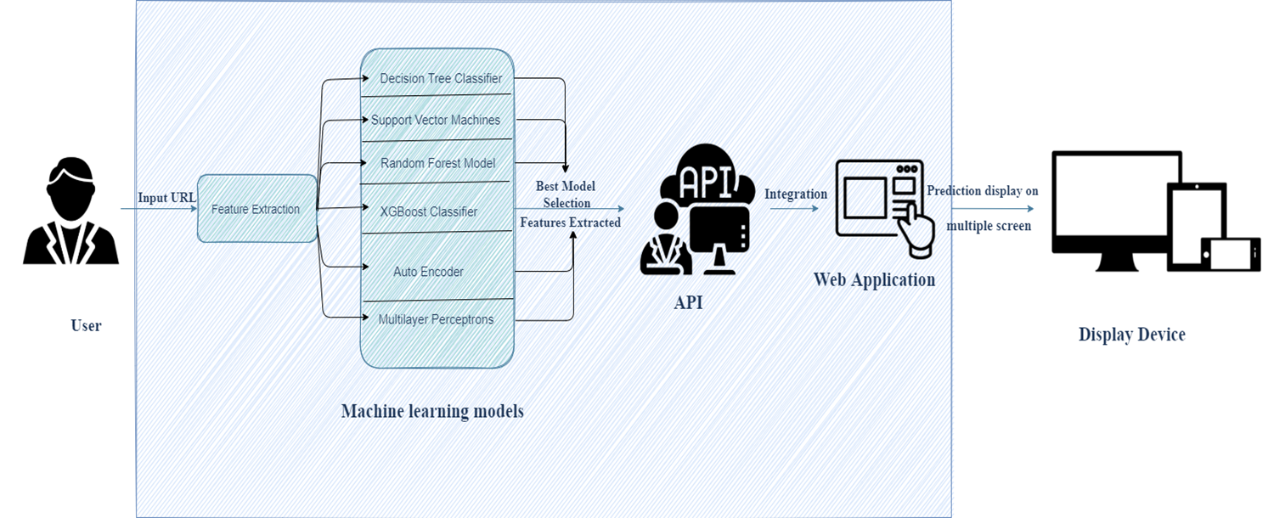

Slide 8

Analysis of Proposed System
Deep neural networks and a variety of machine learning models are utilized in the proposed phishing detection system.
These models are selected after different comparison-based performance of multiple machine learning algorithms.
Each of these models is trained and tested on a website content-based feature, extracted from both phishing and legitimate dataset.
A web application that enables a user to determine whether a URL link is phishing or legitimate is based on the model with the highest accuracy, which is then integrated into the application.

Slide 9

Benefits of Proposed System
1. Will be able to differentiate between phishing(0) and legitimate(1) URLs
2. Will help reduce phishing data breach for organization
3. Will be helpful to individuals and organizations
4. Will be easy to use

Slide 10
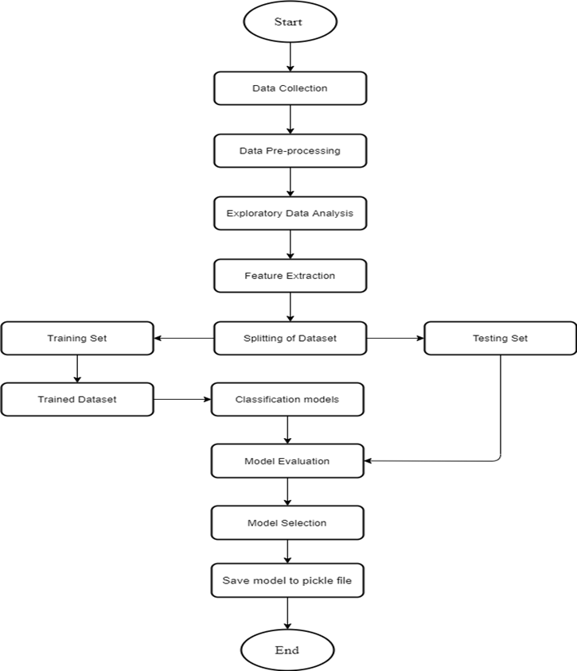
Machine Learning Process

Slide 11
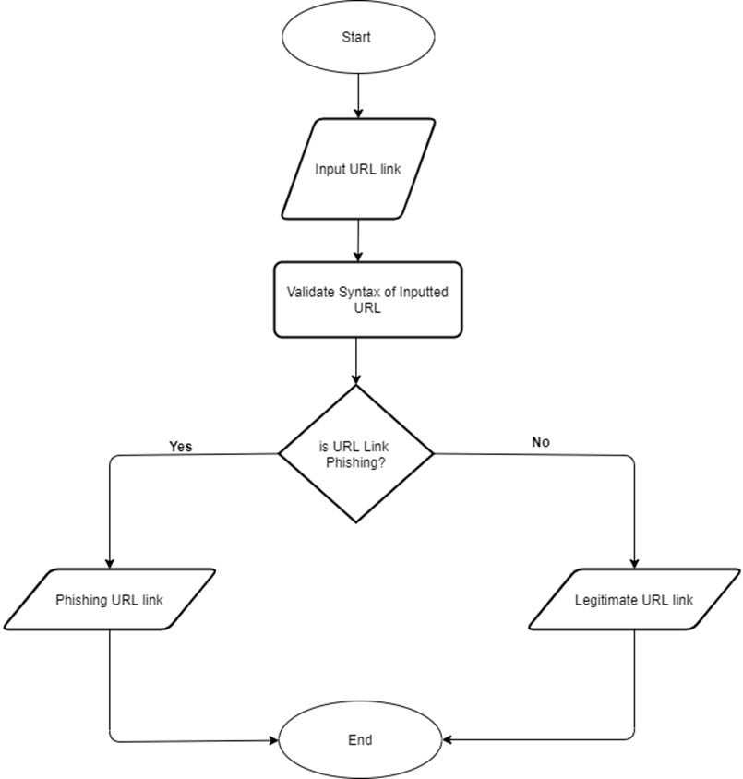
Flowchart of GUI Development

Slide 12
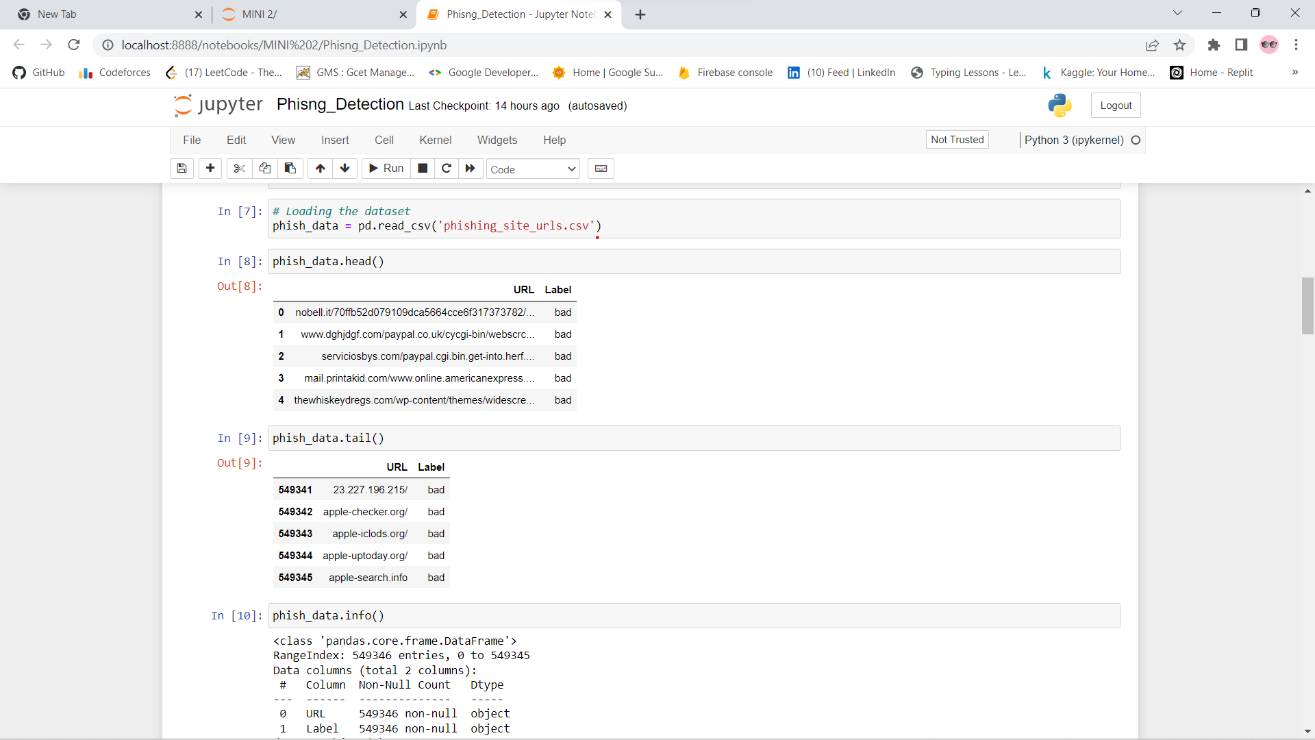
Model Demonstration

Slide 13
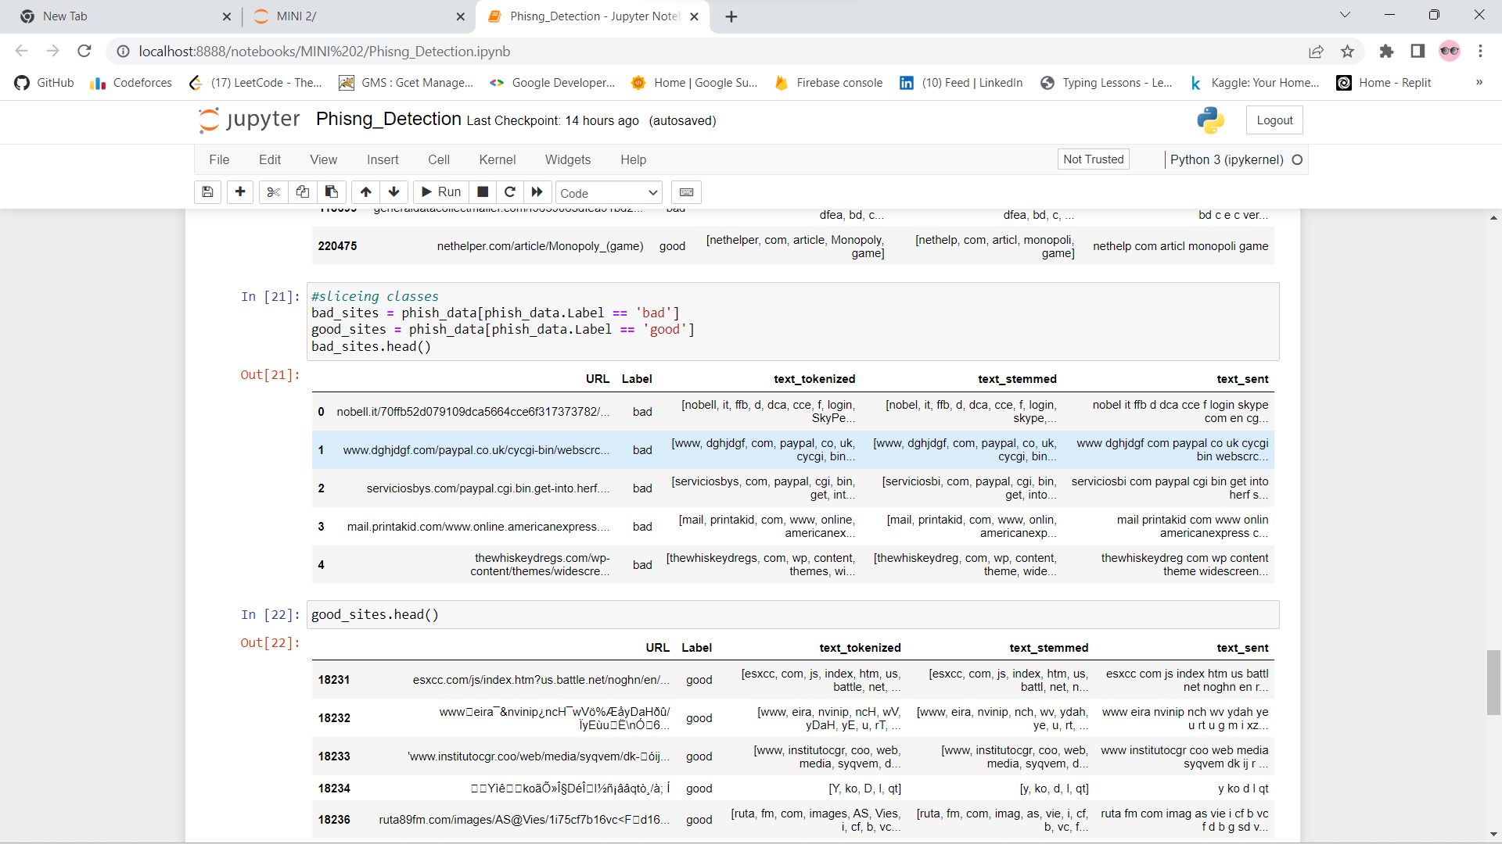
Model Demonstration

Slide 14
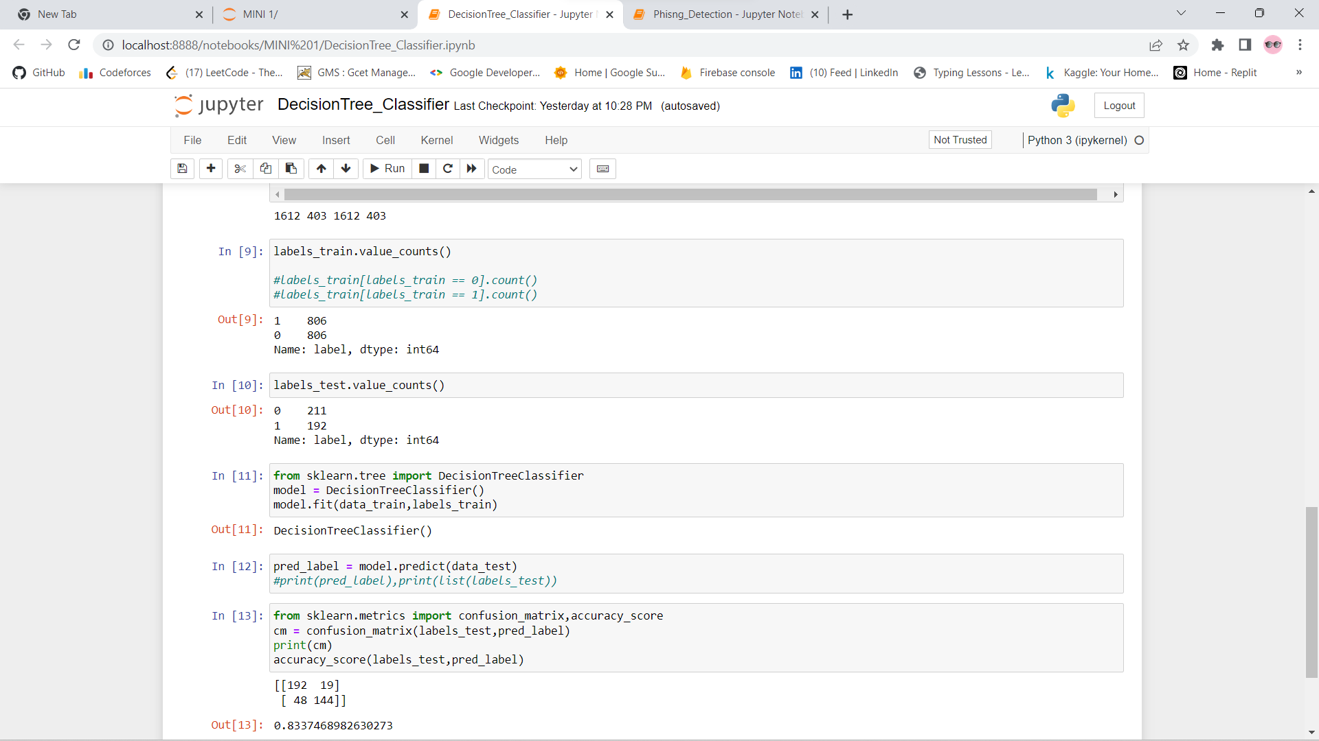
Decision Tree Classifier

Slide 15
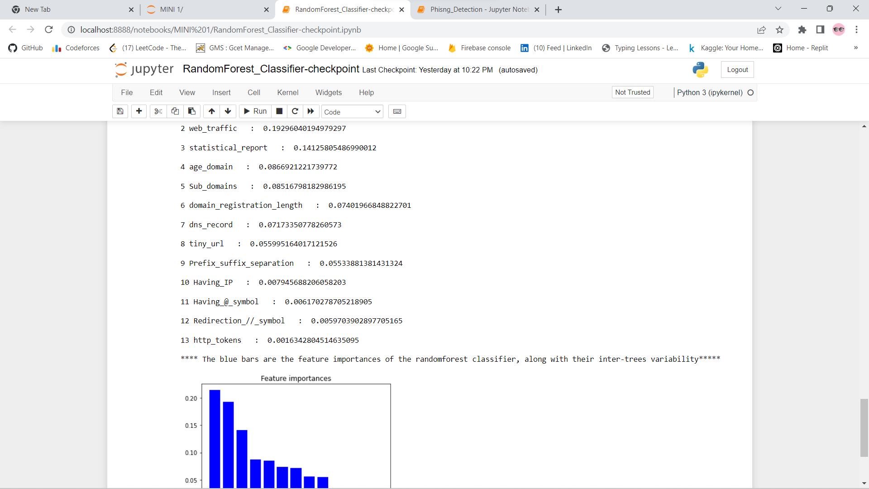
Random Forest Classifier

Slide 16

Impacts of System
This project provides an efficient and effective way for detecting phishing websites (URL) by exploring Data science classification technique.
This project tend to improve the previous technique for detecting phishing websites by employing different machine learning classification models and deep neural network.
This project provides a new and faster way to help users detect if a URL link is phishing or legitimate.

Slide 17

Conclusion
By employing machine learning models, this research aims to assist individuals and organizations in identifying and comprehension phishing techniques used by phishers as well as in effectively and efficiently detecting phishing URL attacks.

Slide 18
Thank You!!!

